Slide 1

Group 22
Unveiling the Correlation:
Does Having Many Healthcare Providers Really Extend Life Expectancy?
Nguyen Le Nguyen Khang
Nguyen Ngoc
Ta Tinh
Tran Dung
Tran Quan

Slide 2
Content
1 Introduction
Research motivation + RQs
2 Dataset overview + processing
3 Results
4 Conclusion + Challenges faced

Slide 3

1. Introduction - Background
Have you ever wondered: pharmacists/doctors hold the secret to a longer life?
Especially populations continue to age and face complex health challenges, the role of healthcare professionals becomes increasingly significant.
In practice, the biggest headache question: Will increasing the number of medical doctors/pharmacists can help to increase life expectancy?

Slide 4

1. Introduction - Background
National Institutes of Health (NIH):
10 additional doctors*
51.5 days increase in life expectancy
* Per 100 000 population, 95% CI
Basu, S., Berkowitz, S. A., Phillips, R. L., Bitton, A., Landon, B. E., & Phillips, R. S. (2019). Association of Primary Care Physician Supply With Population Mortality in the United States, 2005-2015. JAMA internal medicine, 179(4), 506–514. https://doi.org/10.1001/jamainternmed.2018.7624
Notes:
NIH states that: In adjusted mixed-effects regressions, every 10 additional primary care physicians per 100 000 population was associated with a 51.5-day increase in life expectancy (95% CI, 29.5-73.5 days; 0.2% increase)

Slide 5
1. Introduction – Aim & RQs
To have an overview of life expectancy by gender, by continent in year 2000, 2010, 2015
Do females or males tend to have higher life expectancy?
Which continent/country by continent has the highest/lowest life expectancy?
2. To investigate the potential relationship between medical professional density and life expectancy
Is there any correlation between these 2 variables?

Slide 6
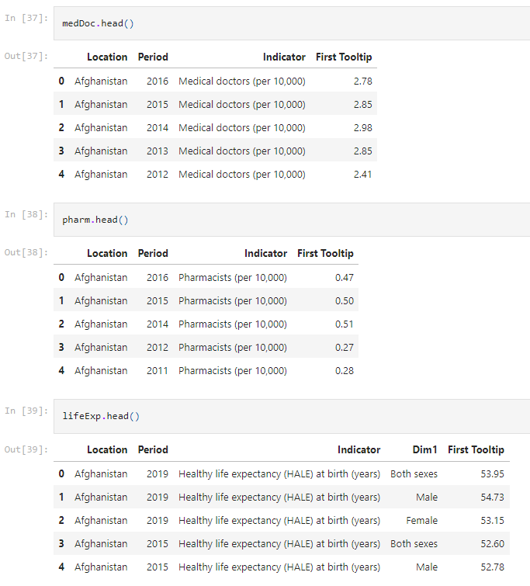
2. Dataset overview + processing
Base dataset: Life Expectancy Dataset (`HALElifeExpectancyAtBirth.csv`)
Location: 6 unique regional aggregations with data entries ranging from 2000 to 2019.
Period: Every 5 years (2000, 2010, 2015, 2019)
Indicator: Consistent across all entries, indicating "Healthy life expectancy (HALE) at birth (years)“
Dim1: Both sexes, male, female
Additional dataset(s): Medical Doctors Dataset (`medicalDoctors.csv`) & Pharmacists Dataset (`pharmacists.csv`)
Location: 180+ unique locations with data entries ranging from 1990 to 2018.
Period: Years of recorded data, with a mean year of 2006.72
Indicator: Consistent across all entries, indicating "Medical Doctors/Pharmacists (per 10,000)".
First Tooltip: Numeric values representing the number of medical doctors/pharmacists per 10,000 population
Doctors: ranging from 0.13 to 84.22, with a mean of 20.685.
Pharmacists: ranging from 0.002 to 26.3, with a mean of 4.124
World Health Statistics 2020|Complete|Geo-Analysis (kaggle.com)
Notes:
Base dataset:
Healthy life expectancy (HALE) = Average number of years that a person can expect to live in "full health" by taking into account years lived in less than full health due to disease and/or injury.
Expected frequency of data collection: every 5 years (2000 → 2010 → 2015 → 2019)

Slide 7
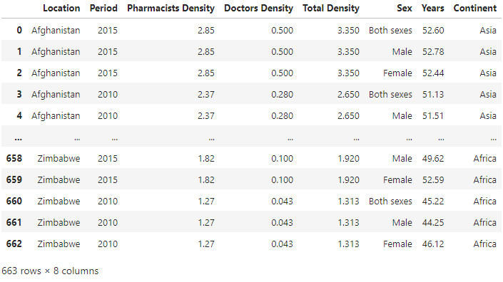
2. Dataset overview + processing
Step 1: Merge 2 additional datasets based on location and period
Total density = Doctors density + Pharmacists density
Step 2: Merge the base dataset with additional datasets (inner join)
After merged, the final dataset only includes 3 years: 2000, 2010, 2015
Step 3: Create “Continent” column
Step 4.5.6...
Notes:
4.5.6 (checking null values, etc)…. We don’t have time to go through all steps ☺ so above are the main steps only!!

Slide 8

3. Results

Slide 9
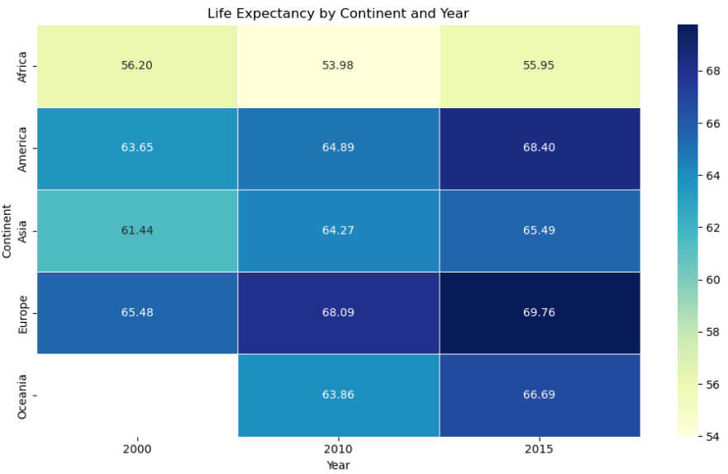
3.1. Life Expectancy overview – by continent
Europe tends to have the highest average life expectancy
Africa consistently exhibits the lowest average life expectancy among the five continents.
All continents have experienced an overall increase in life expectancy over the years.
However, Africa - a slight decrease in life expectancy in 2010 compared to other years.
What happened in Africa from 2001 to 2010? HIV/AIDS Epidemic, Darfur Conflict (Sudan) → might lead to a decrease in life expectancy of Africa
Note: Data of Oceania in 2000 is missing from the original dataset.
Notes:
Generally, Europe tends to have the highest average life expectancy (around 65 - 69.79 years).** This is followed by America, with an average life expectancy falling between approximately 63 to 68.39 years, and Oceania, with a range of approximately 63 to 66.67 years. Asia follows closely, with an average life expectancy spanning from approximately 61 to 65.49 years. Africa consistently exhibits the lowest average life expectancy among the five continents, ranging from approximately 54 to 55.94 years.
Furthermore, it is noteworthy that all continents have experienced an overall increase in life expectancy over the years. However, Africa stands out as it experienced a slight decrease in life expectancy in 2010 compared to other years. The period from 2001 to 2010 in Africa was marked by a combination of significant events and challenges across the continent. While it is difficult to provide an exhaustive list, there are some notable occurrences during this time frame, which might lead to a decrease in life expectancy of Africa, such as HIV/AIDS Epidemic, Darfur Conflict (Sudan) (which began in the early 2000s, escalated during this period, leading to widespread violence, displacement, and humanitarian crises).

Slide 10
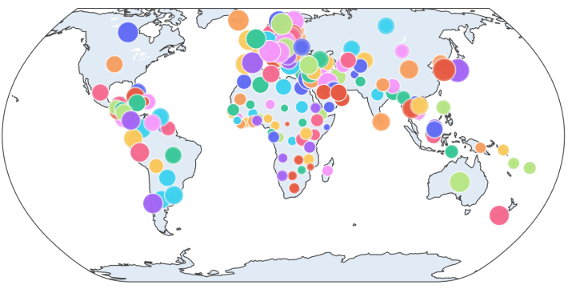
3.1. Life Expectancy overview – by country
Many big bubbles cluster around EU (.g. Italy, France, Estonia,..)
→ high life expectancy
Africa seems to not have any big bubble
→ low life expectancy

Slide 11
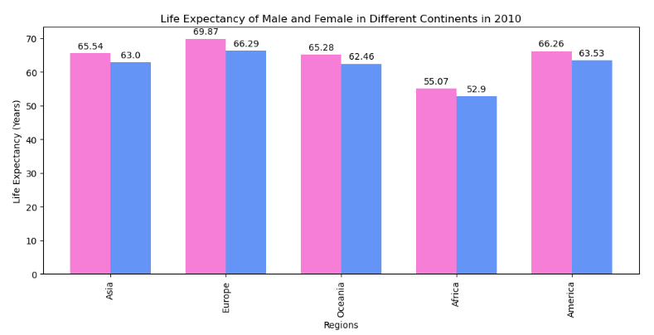
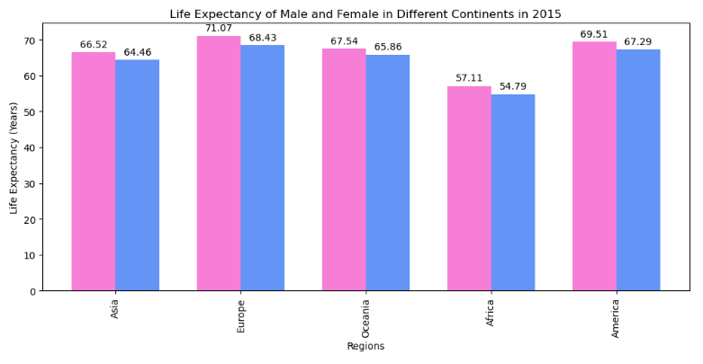

3.2. Life Expectancy by Gender
3.58 years
In general, females tend to have a higher average life expectancy than males across all continents.
Europe has the highest difference between the average life expectancy of females and males, ranging from approximately 3 to 4.8 years, whereas for other continents, the difference typically falls within the range of 1 to 2.7 years
2.06 years
Notes:
Interpretation:
In general, females tend to have a higher average life expectancy than males across all continents. The same trend (as mentioned above) was witnessed here, with Europe consistently exhibiting higher life expectancy for both genders compared to other continents. Over the years, there has been an overall increase in life expectancy for both genders across all continents, except for Africa, which experienced a slight decrease in 2010.
Interestingly, we observed that Europe has the highest difference between the average life expectancy of females and males, ranging from approximately 3 to 4.8 years, whereas for other continents, the difference typically falls within the range of 1 to 2 years

Slide 12

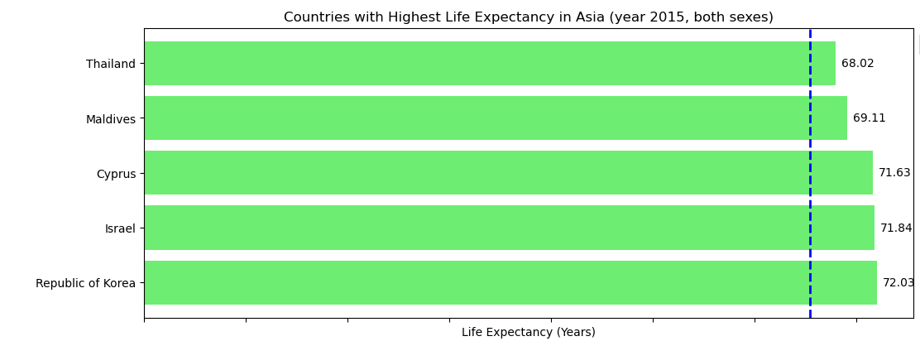
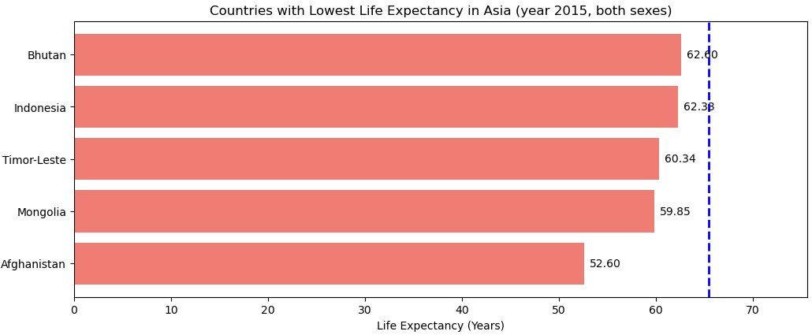
3.3. Countries with Highest/Lowest life expectancy - Asia
Notes:
Now, we will delve deeper into each continent to identify the top five and bottom five countries with the highest and lowest life expectancy, respectively, based on the most recent year available in the original dataset. Therefore, in this section, we exclusively analyze the data of the year 2015.

Slide 13

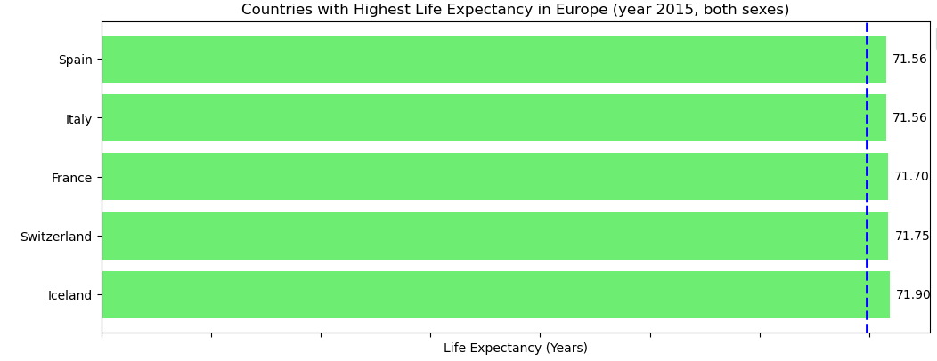
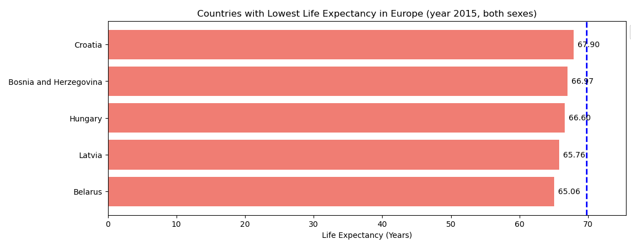
3.3. Countries with Highest/Lowest life expectancy - Europe

Slide 14

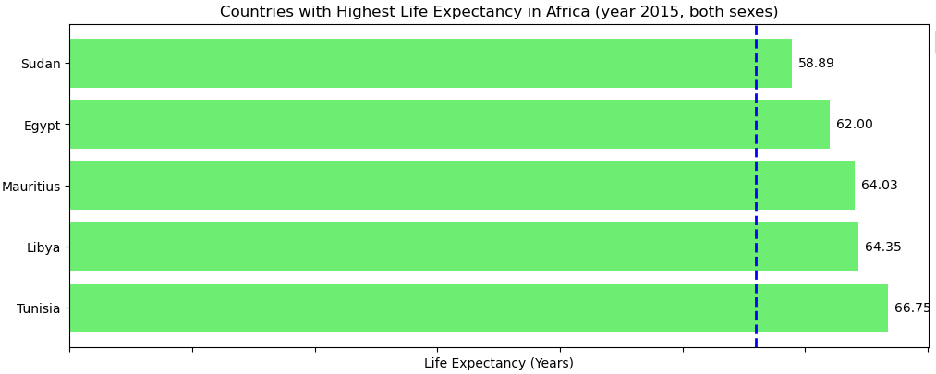
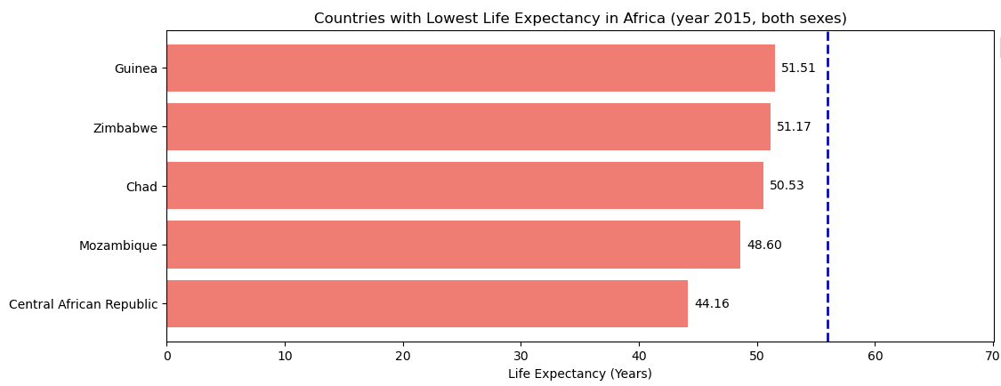
3.3. Countries with Highest/Lowest life expectancy - Africa

Slide 15
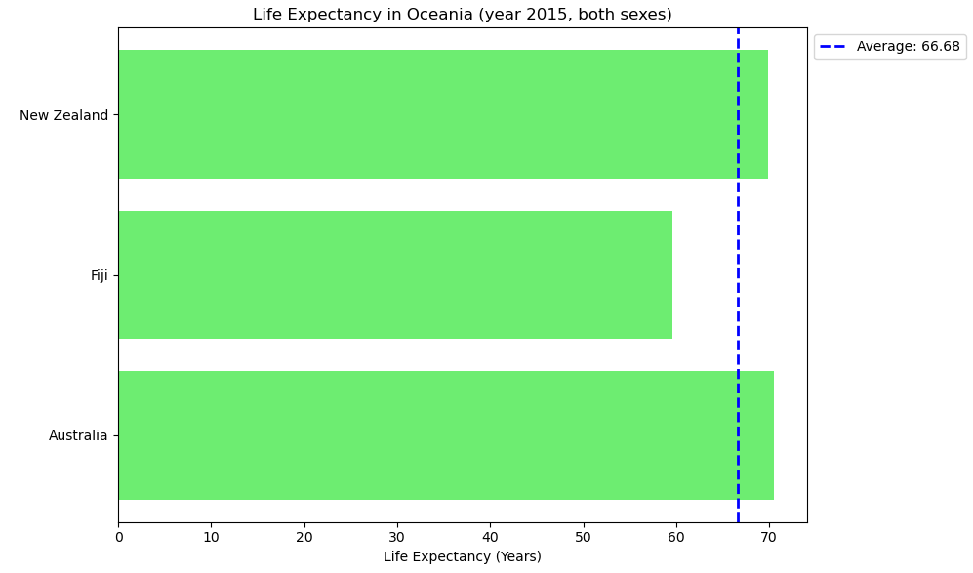
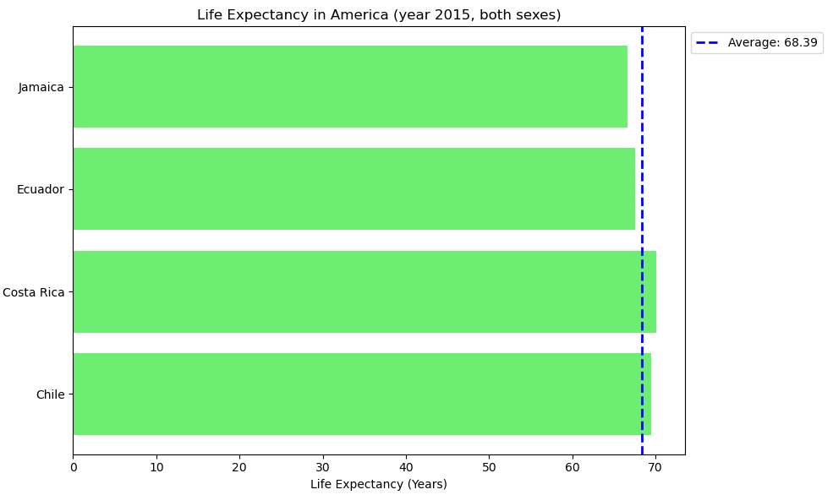
3.3. Countries with life expectancy – Oceania & America
Note: Because Oceania and America only have few countries, we plot all countries, instead of identifying top/bottom countries.

Slide 16

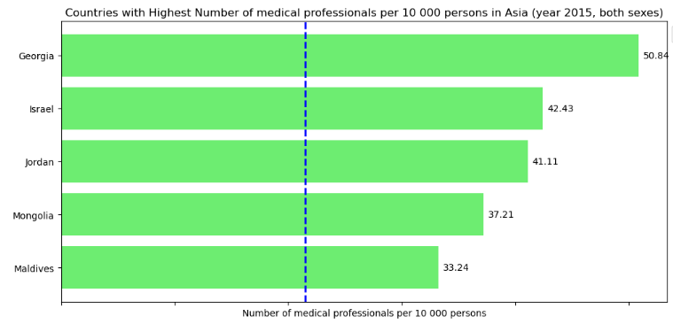
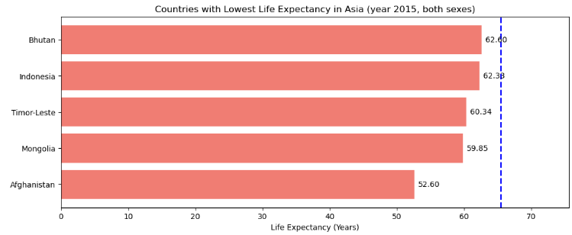
3.4 Relationship between Life Expectancy vs Medical Professional density
Interesting observation: Mongolia
Notes:
Mongolia ranks among one of the top countries in terms of medical professional density, but it exhibits a relatively low life expectancy. Hence, now we are interested to explore the positions of countries having the highest medical professional densities in life expectancy map - which is illustrated in the next graph.

Slide 17
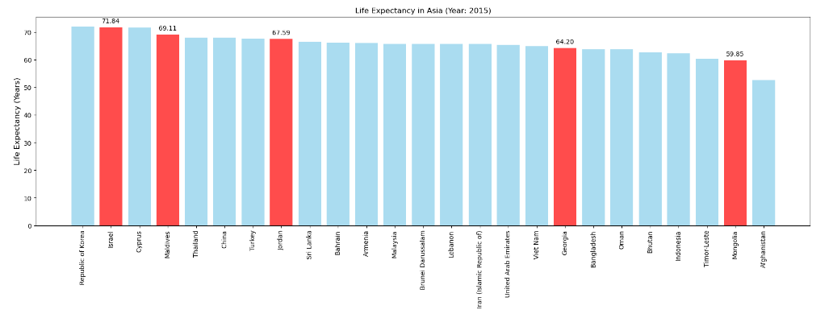
3.4 Relationship between Life Expectancy vs Medical Professional density
ASIA
Top countries with highest number of medical professionals– where are we?
Countries with highest medical professional density

Slide 18
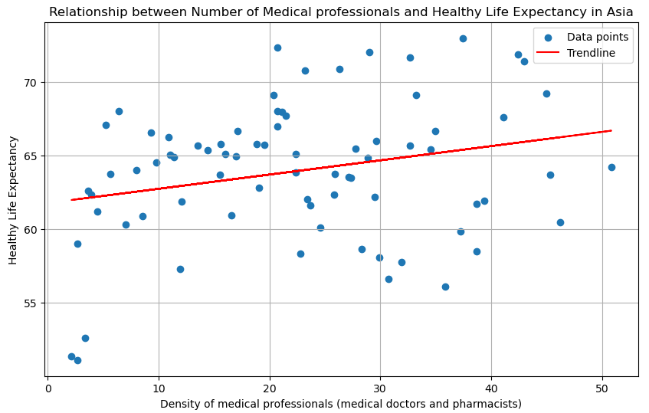
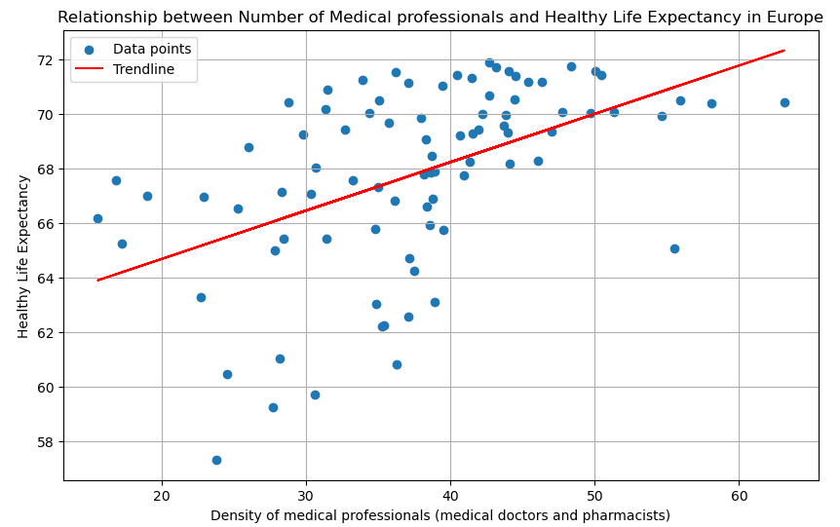
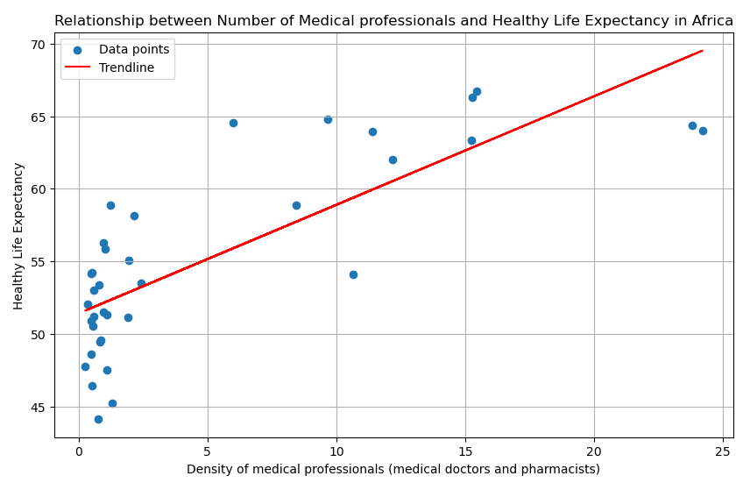
3.4 Relationship between Life Expectancy vs Medical Professional density

Slide 19
4. Conclusion
Top countries with the highest medical professional density do not necessarily have the highest life expectancy.
In Europe, we observe a somewhat clearer positive correlation between medical professional density and life expectancy,
In general, the relationship between these factors appears nuanced across all continents.
This discrepancy suggests that while access to healthcare providers is undoubtedly crucial, other determinants are also important:
quality of healthcare systems
healthcare infrastructure, socioeconomic factors (income, education, employment opportunities, and social support networks)
lifestyle choices (nutrition, diet, etc.)
environmental conditions (air and water quality)

Slide 20
4. Conclusion
RQs REVISITED
To have an overview of life expectancy by gender, by continent in year 2000, 2015, 2019
Do females or males tend to have higher life expectancy?
→ Female
Which continent/country by continent has the highest/lowest life expectancy?
→ Previous slides
2. To investigate the potential relationship between medical professional density and life expectancy
Is there any correlation between these 2 variables?
→ Nuanced

Slide 21


4. Conclusion
Challenges faced
Before:
After merging datasets, only data of 3 years remained.
Encountered null values when converting to continents
(in some countries i.e. “Bolivia (Plurinational State of)”, “Iran (Islamic Republic of”, “Republic of Korea”, etc.)
→ solution: use country_converter library
Data visualization team
Nguyen Le Nguyen Khang
Nguyen Ngoc
Tran Dung
Data “cleaner” team
Ta Tinh
Tran Quan
After:

Slide 22

Thank you!

Slide 23
Appendix

Slide 24
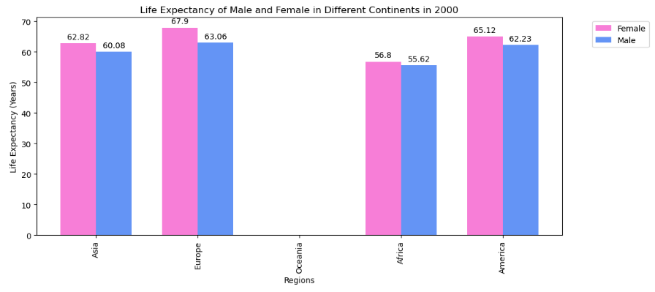
A1. Life Expectancy by Gender year 2000
Note: Data of Oceania in 2000 is missing from the original dataset.

Slide 25
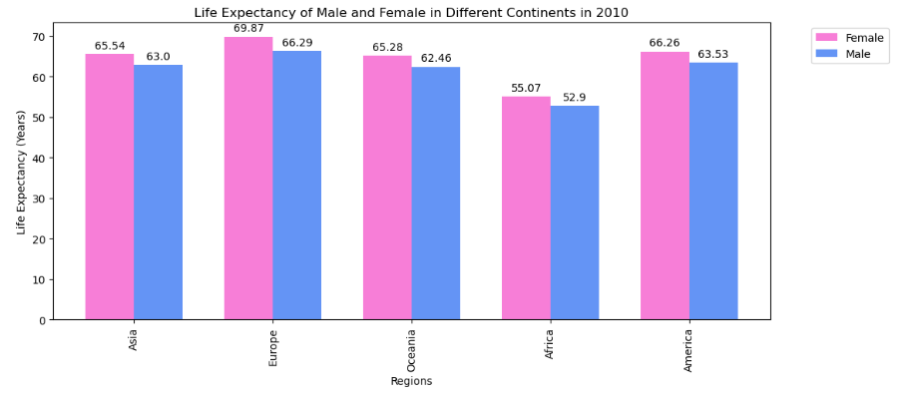
A2. Life Expectancy by Gender year 2010

Slide 26
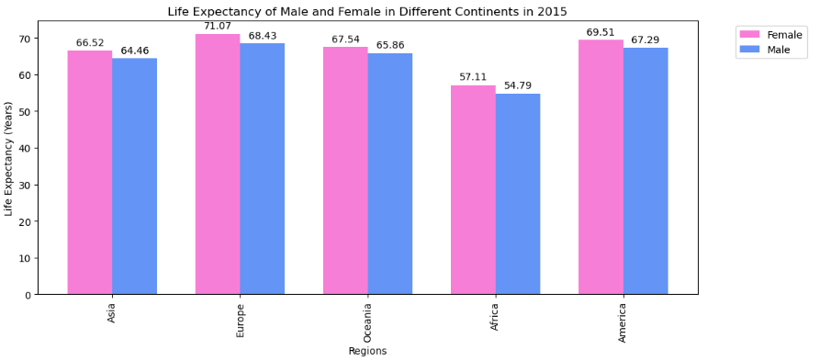
A3. Life Expectancy by Gender year 2015

Slide 27
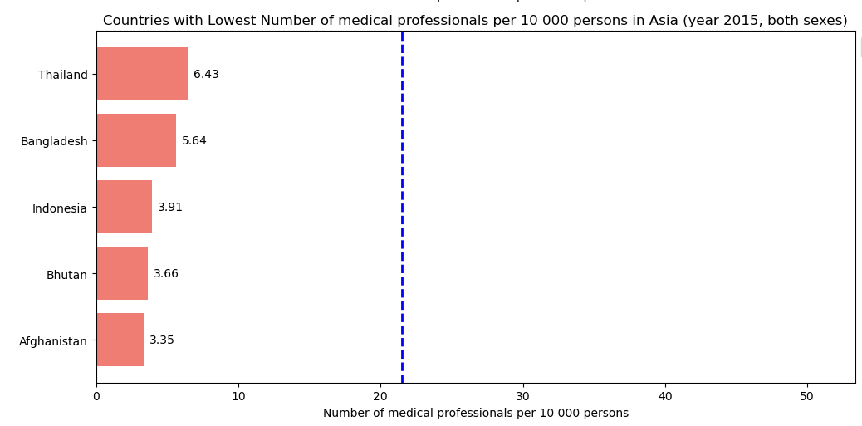
A4. Relationship between Life Expectancy vs Medical Professional density
Another Interesting observation: Thailand
Notes:
Thailand ranks among the countries with the lowest medical professional density, yet it still achieves the highest life expectancy in Asia. Hence, now we are interested to explore the positions of countries having the highest medical professional densities in life expectancy map - which is illustrated in the next graph.

Slide 28
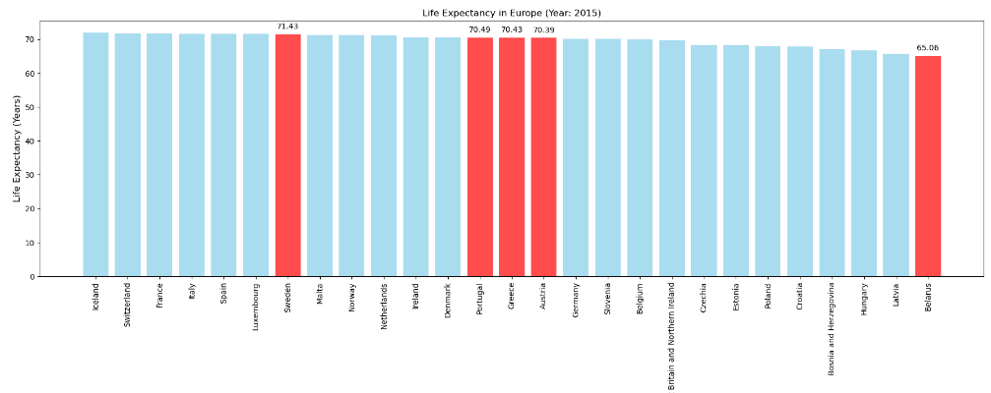
A5. Relationship between Life Expectancy vs Medical Professional density
EUROPE
Top countries with highest number of medical professionals– where are we?
Countries with highest medical professional density

Slide 29
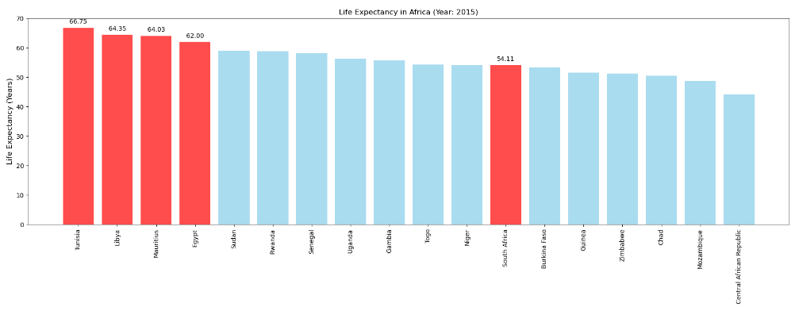
A6. Relationship between Life Expectancy vs Medical Professional density
AFRICA
Top countries with highest number of medical professionals– where are we?
Countries with highest medical professional density

